Slide 1

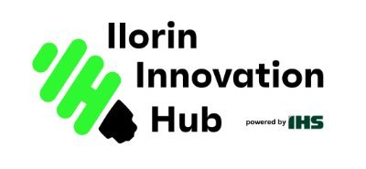
AI-Ready Workforce Transformation Proposal for
IHS Nigeria
Prepared by Temi Kolawole
Managing Director, Ilorin Innovation Hub
August 26, 2025

Slide 2

AI-Ready Workforce Transformation Proposal for IHS Nigeria
Document Outline
Executive Summary
Context & Rationale
Skills Mapping & Talent Gaps
Reskilling & Upskilling Strategy
Responsible AI in HR Operations
Role-by-Role AI Impact
Change Management & Culture Enablement
Roadmap & Operating Model (2025–2028)
KPIs, Benefits & Risks
Conclusion
Appendices

Slide 3
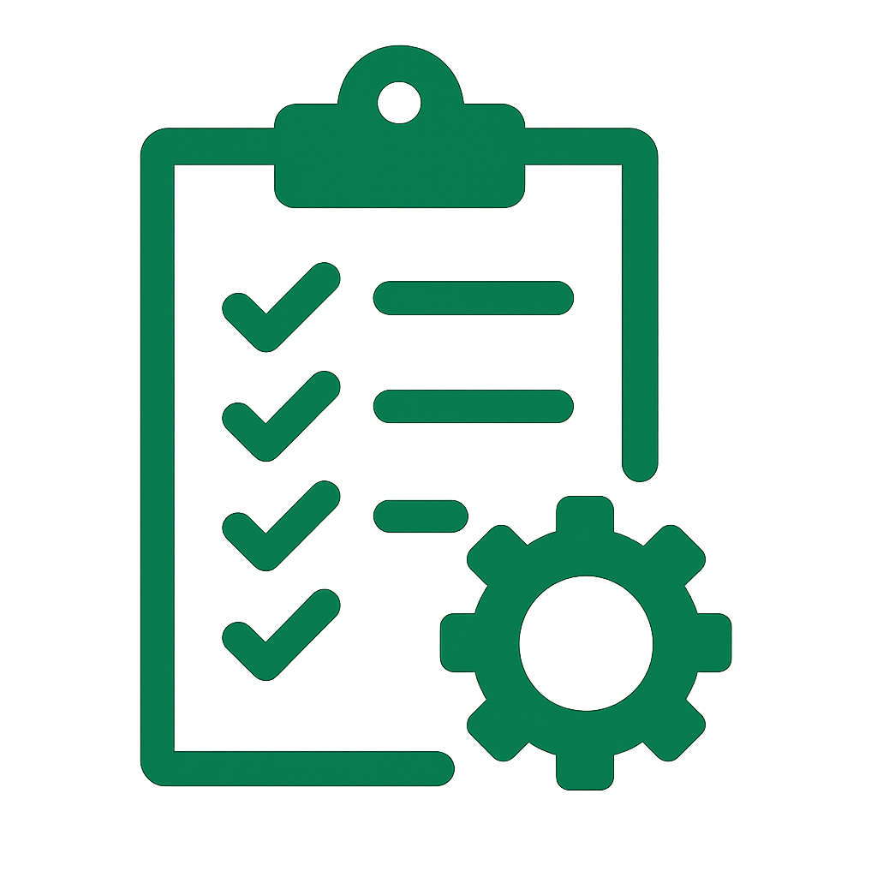
AI-Ready Workforce Transformation Proposal for IHS Nigeria
Executive Summary
Why Now
AI is reshaping telecom operations; Nigeria faces unique digital literacy, training, and infrastructure challenges.
Strategic Goal
Prepare IHS Nigeria’s workforce for AI adoption with a phased 12–36 month roadmap.
Guiding Principles
No-forced-layoffs – focus on reskilling and redeployment.
Nigeria-first, global-aware – tailored to local realities, aligned with global best practices.
Expected Outcomes:
20–30% faster HR and back-office processes.
10% workforce capacity redeployment through automation.
Faster hiring cycle (8 → 6 weeks) and safer field operations.
Compliance with NDPA 2023, Labour Act, PENCOM, and NCC guidance.

Slide 4

AI-Ready Workforce Transformation Proposal for IHS Nigeria
Context & Rationale
Global Shift
Telecom towercos worldwide (American Tower, Helios, SBA) are embedding AI into HR, maintenance, and energy optimization.
Strategic Imperative
AI adoption can boost productivity, cut Opex, and improve ESG performance.
Without workforce readiness, tech investments risk underutilization.
Why Workforce AI Readiness Matters Now
Nigeria’s Workforce Realities:
Uneven digital literacy across regions.
Limited access to advanced training outside urban hubs.
Active union structures requiring early engagement.
Infrastructure gaps (power, connectivity) affecting rollout.
Opportunity: IHS Nigeria can lead in Africa by combining AI with responsible workforce transformation.

Slide 5

AI-Ready Workforce Transformation Proposal for IHS Nigeria
Skills Mapping & Talent Gaps
Current Capabilities
Strong telecom/engineering expertise; limited AI/data literacy across most roles.
New Roles Emerging
AI Product Owner, Data Analyst/Engineer, MLOps Specialist, AI Ethics & Compliance Lead.
Current vs. Future Workforce Needs
Future Needs:
Leadership/Board: AI-driven decision dashboards, scenario modeling.
Middle Management: Data literacy, AI-augmented planning & reporting.
Field/Operational Staff: Predictive maintenance tools, AR/AI-enabled workflows, safety monitoring.
Back-Office Teams: HR, finance & procurement automation.
Training Requirement
40–120 hours per role category, phased over 12–36 months.

Slide 6

AI-Ready Workforce Transformation Proposal for IHS Nigeria
Reskilling & Upskilling Strategy
Three-Tier Learning Framework (2025–2028)
Delivery Model:
Internal “AI Academy” for IHS Nigeria.
Partnerships with Nigerian universities, hubs (CcHub, ALX, Decagon).
Certifications from AWS, Microsoft, Google.
Investment & ROI:
Training budgets in ₦ and US$ scenario ranges.
Payback: higher productivity, faster hiring, improved retention.
Tier 1 – AI Awareness (All Staff):
Tier 2 – Data Literacy (Managers & Staff):
Tier 3 – Deep Technical Skilling (Select Cohorts):
Short modules on AI basics, ethics, and use cases in telecom.
Hands-on training in analytics, dashboards, and AI-supported planning.
Specialized programs in AI/ML, MLOps, and data engineering.

Slide 7

AI-Ready Workforce Transformation Proposal for IHS Nigeria
Responsible AI in HR Operations
Embedding AI into HR with Trust & Compliance
Priority Use Cases:
Recruitment & candidate screening.
Internal mobility & succession planning.
Performance insights & workforce forecasting.
HR service chatbots for staff support.
Governance & Compliance:
Align with NDPA 2023/NDPR, Labour Act, PENCOM, NCC guidance.
Human-in-the-loop for all critical decisions.
Bias detection, explainability, and appeal mechanisms built in.
Strategic Outcome:
More efficient, fair, and data-driven HR processes.
Workforce trust strengthened through transparency & safeguards.

Slide 8

AI-Ready Workforce Transformation Proposal for IHS Nigeria
Role-by-Role AI Impact
Transforming Work Across All Levels
Leadership / Board
Middle Management
Field & Operational Staff
Back-Office Teams
AI dashboards for real-time decision-making & scenario modeling.
AI-augmented planning, reporting, and resource allocation.
Data-driven performance tracking.
Predictive maintenance tools to reduce downtime.
AR/AI-assisted workflows & safety monitoring.
HR, Finance, and Procurement automation.
AI-enabled service chatbots for routine tasks.
Outcome
Every role benefits from AI — productivity gains, safer operations, and better decision support.

Slide 9

AI-Ready Workforce Transformation Proposal for IHS Nigeria
Change Management & Culture Enablement
Building a Workforce Ready for AI
Communication & Engagement
Culture & Trust
Capability Building
Clear, ongoing messaging on AI’s role and benefits.
Early engagement with unions and key stakeholders.
No-forced-layoffs principle; redeployment & reskilling first.
Recognition & incentives for AI adoption champions.
“Day-in-the-life after AI” workshops per role.
Local champions network to drive adoption.
Outcome
Smooth transition to AI-enabled work, high workforce confidence, and minimized resistance.

Slide 10

AI-Ready Workforce Transformation Proposal for IHS Nigeria
Roadmap & Operating Model
Phased Transformation Journey
Phase 1 (0–6 months)
Phase 2 (6–18 months)
Phase 3 (18–36 months)
Skills mapping, AI awareness sessions.
Pilot projects in HR operations & field tools.
Scale training across all tiers.
AI dashboards integrated into management workflows.
Certification of managers & technical staff.
Institutionalize AI through an innovation hub.
Continuous learning & career pathways embedded.
AI integrated into SOPs across functions.
Operating Model
RACI framework covering HR, Ops, IT/AI CoE, and Compliance.
Outcome
Structured, sustainable AI adoption aligned with IHS Nigeria’s strategy.

Slide 11

AI-Ready Workforce Transformation Proposal for IHS Nigeria
KPIs, Benefits & Risks
Measuring Success & Managing Challenges
Key KPIs
Expected Benefits (Base Case):
Risks & Mitigations
Training completion & proficiency levels.
AI tool adoption/utilization rates.
Time-to-hire & time-to-productivity.
Attrition & internal mobility rates.
HR cycle-time reductions & safety incident rates.
NDPA compliance audit results.
20–30% faster HR/back-office cycle-times.
~10% workforce capacity redeployed through efficiency.
Hiring cycle reduced from 8 → 6 weeks.
Safer, more reliable field operations.
Adoption resistance → targeted comms & incentives.
Skills gaps → phased reskilling programs.
Data privacy/regulatory risks → strong compliance controls.
Outcome
Balanced approach delivering measurable ROI while managing people and regulatory risks.

Slide 12

AI-Ready Workforce Transformation Proposal for IHS Nigeria
Conclusion
AI-Ready Workforce Transformation Plan (2025–2028)
What the Plan Achieves:
Maps current vs. future workforce skills across all roles.
Defines a 3-tier reskilling & upskilling framework with Nigerian and global partners.
Embeds responsible AI practices in HR operations (fairness, compliance, transparency).
Outlines role-by-role AI impact to boost productivity, safety, and decision-making.
Provides a phased 12–36 month roadmap with KPIs, benefits, and risk mitigations.
Overall Outcome: A clear, pragmatic strategy to make IHS Nigeria’s workforce AI-ready, future-proof, and regionally competitive while maintaining trust and compliance.
Next Steps:
Secure HR leadership endorsement.
Launch skills mapping & awareness pilots within 6 months.
Formalize partnerships with training providers and regulators.
Establish an AI Center of Excellence to coordinate rollout.

